Slide 1
Fidaxomicin compared to vancomycin for the treatment of C. diff
Almedina Pargan, Doctor of Pharmacy Candidate 2024

Slide 2
Objectives
Apply treatment guidelines for the recommendation of C.diff
Briefly describe fidaxomicin and vancomycin
Analyze primary literature regarding the safety and efficacy of fidaxomicin and vancomycin
Determine which patient population should receive treatment with fidaxomicin

Slide 3
Clostridioides difficile (C. difficile)¹
A bacterium that causes diarrhea or inflammation of the colon
Each year, nearly half a million Americans are infected
Between 2 and 8 weeks, a recurrence affects 1 in 6 patients

Slide 4
Risk factors²
Antibiotics
> 65 years old
Immunocompromised
Recent hospitalization or nursing home stay

Slide 5
Diagnosis³
Symptomatic: must present with 3 or more unformed stools in 24 hours and
a positive GDH and C. diff toxin
or
positive NAAT

Slide 6
C. Diff Severity⁴
Nonsevere
WBC count <15,000 cells/mL and SCr <1.5 mg/dL
Severe
WBC count >15,000 cells/mL or SCr >1.5 mg/dL
Fulminant
Hypotension, shock, or toxic megacolon
Notes:
https://gi.org/topics/c-difficile-infection/

Slide 7
Clinical Question
Fidaxomicin or PO vancomycin for CDI, when should we use fidaxomicin as 1st line therapy or in what patient population?

Slide 8
Fidaxomicin⁵
Classification
Macrolide
Warnings
Hypersensitivity, avoid use in systemic infections
ADEs
GI symptoms, hyperglycemia, dermatologic rxns

Slide 9
Vancomycin⁶
Classification
Glycopeptide
Warnings
Nephrotoxicity, ototoxicity
ADEs
Hypokalemia, GI symptoms, peripheral edema

Slide 10
2021 IDSA Guideline⁷

Slide 11
Prevention⁸
Wash Hands
PPE
Antimicrobial stewardship

Slide 12
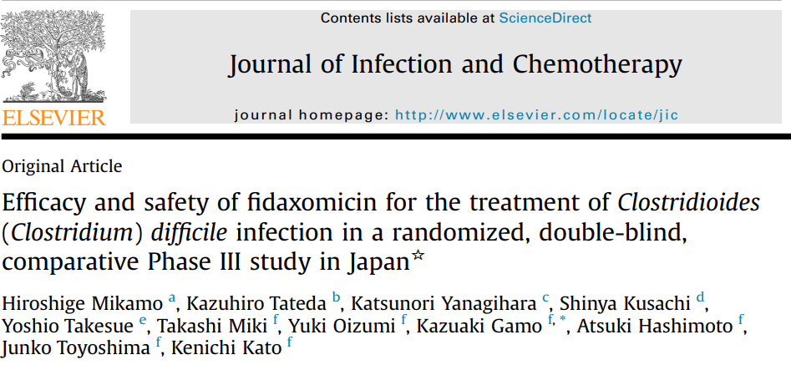
Study No. 1⁹
Mikamo H, Tateda K, Yanagihara K, et al. Efficacy and safety of fidaxomicin for the treatment of Clostridioides (Clostridium) difficile infection in a randomized, double-blind, comparative Phase III study in Japan. J Infect Chemother. 2018;24(9):744-752. doi:10.1016/j.jiac.2018.05.010

Slide 13
Study No. 1⁹ | Mikamo H, Tateda K, Yanagihara K, et al. Efficacy and safety of fidaxomicin for the treatment of Clostridioides (Clostridium) difficile infection in a randomized, double-blind, comparative Phase III study in Japan. J Infect Chemother. 2018;24(9):744-752. doi:10.1016/j.jiac.2018.05.010.
Objective | To demonstrate non-inferiority of fidaxomicin vs. vancomycin
Design | Phase III, randomized, double-blind, parallel-group, vancomycin controlled study
Inclusion Criteria | Hospitalized patients Age >20 years Not received an abx for tx of CDI, or tx failure after 3 days of metronidazole therapy
Exclusion Criteria | Life-threatening or fulminant CDI, paralytic ileus, toxic megacolon Prior use of fidaxomicin Concomitant use of abx for the tx of CDI 2 >/- episodes of CDI within the past 3 months Requirement for antidiarrheal drugs
Methods | 212 adult patients with CDI randomized to group 1 or group 2 Fidaxomicin (Group 1): n=104 Fidaxomicin 200 mg 1 tab PO BID for 10 days Vancomycin placebo PO for 10 days Vancomycin (Group 2): n=109 Fidaxomicin placebo 1 tab PO BID for 10 days Vancomycin (reconstituted powder) 125g mg PO QID for 10 days
Primary Efficacy Endpoint | Global cure rate of CDI at the EOT, and no recurrence during the 28 day follow up

Slide 14
Results⁹
10% was set as the non-inferiority margin
Global cure rate [FAS]:
Fidaxomicin 67.3% (70/104)
Vancomycin 65.7% (71/108)
Difference: 1.2% [95% CI -11.3-13.7]
Post-hoc analysis: full analysis set of patients who received at least 3 days of tx
Global cure rate:
Fidaxomicin 70/97 (72.2%)
Vancomycin 71/106 (72.2%)
Difference: 4.6% [-7.9-17.1]
Recurrence rate [FAS]:
Fidaxomicin: 17/87 (19.5%)
Vancomycin: 24/95 (25.3%)
ADE were similar between both groups

Slide 15
Conclusion⁹
Non-inferiority of fidaxomicin vs. vancomycin was NOT demonstrated
Global cure rates were higher in fidaxomicin group
Recurrence rate lower in fidaxomicin group
Fidaxomicin can be a treatment option for CDI and can be used to reduce the recurrence of CDI

Slide 16
Strengths and Limitations⁹
Strengths
Randomization
Double-blinded
Adequate follow-up time
Safety analysis (vitals, ADEs, mortality)
Received patients' informed consent
Limitations
Hospitalized patients only
Limited generalizability

Slide 17
Study No. 2¹⁰
Guery B, Menichetti F, Anttila VJ, et al. Extended-pulsed fidaxomicin versus vancomycin for Clostridium difficile infection in patients 60 years and older (EXTEND): a randomised, controlled, open-label, phase 3b/4 trial. Lancet Infect Dis. 2018;18(3):296-307. doi:10.1016/S1473-3099(17)30751-X.

Slide 18
Study No. 2¹⁰ | Guery B, Menichetti F, Anttila VJ, et al. Extended-pulsed fidaxomicin versus vancomycin for Clostridium difficile infection in patients 60 years and older (EXTEND): a randomised, controlled, open-label, phase 3b/4 trial. Lancet Infect Dis. 2018;18(3):296-307. doi:10.1016/S1473-3099(17)30751-X.
Objective | To compare the clinical efficacy of extended-pulsed fidaxomicin to that of vancomycin
Design | Randomized, controlled, open-label study of superiority
Inclusion Criteria | Hospitalized patients Age > 60 years Dx CDI
Exclusion Criteria | C.Diff infection therapy for more than 1 day within the past 48h >2 C.diff infections in the previous three months prior to the study Pts diagnosed with inflammatory bowel disease
Methods | 364 adult patients, >60 years of age with CDI randomized to group 1 or group 2 Extended pulsed fidaxomicin (Group 1): n=183 Fidaxomicin 200 mg 1 tab PO BID on days 1-5, then Fidaxomicin 200 mg 1 tab PO QD on days 7-25 Vancomycin (Group 2): n=181 Vancomycin 125 mg 1 Caps QID on days 1-10

Slide 19
Study No. 2¹⁰ | Guery B, Menichetti F, Anttila VJ, et al. Extended-pulsed fidaxomicin versus vancomycin for Clostridium difficile infection in patients 60 years and older (EXTEND): a randomised, controlled, open-label, phase 3b/4 trial. Lancet Infect Dis. 2018;18(3):296-307. doi:10.1016/S1473-3099(17)30751-X.
Primary Endpoint | Clinical cure 30 days after treatment ended (day 55 for extended-pulsed fidaxomicin and day 40 for vancomycin) All eligible randomized patients who received at least a single dose of trial medication were assessed
Secondary Endpoints | At days 40, 55, and 90, for both treatment groups sustained clinical cure of C difficile infection Clinical response to vancomycin and extended-pulsed fidaxomicin at day 12 and 2 days after therapy discontinuation (day 12 or day 27 for vancomycin and extended-pulsed fidaxomicin, respectively) From the start of treatment, the duration to resolve diarrhea C.Diff infection recurrence on days 40, 55, and 90 Time to recurrence of C difficile infection after therapy

Slide 20
Results¹⁰
Primary endpoint
Extended pulsed fidaxomicin 70.0% (124/177)
Vancomycin 59.0% (106/179)
Difference: 11% [95% CI 1.0–20.7], p=0.030; odds ratio 1.62 [95% CI 1.04–2.54]
Secondary endpoints
At days 40, 55, and 90, more fidaxomicin patients had maintained clinical cure of C difficile infection
The rate of recurrence was less in the fidaxomicin group than in the vancomycin group (p<0.0001)
C.Diff infection recurrence was lower in the fidaxomicin group on days 40, 55, and 90 compared to the vancomycin group
ADE were similar between both groups
Extended pulsed fidaxomicin 67% (121/181)
Vancomycin 71% (128/181)
1 death was reported in vancomycin group

Slide 21
Conclusion¹⁰
Extended-pulsed fidaxomicin outperformed conventional vancomycin for the long-term treatment of C difficile infection
In patients above the age of 60, extended-pulsed fidaxomicin was superior when compared to vancomycin for the primary goal of sustained clinical cure
In the fidaxomicin group, the recurrence rate was lower than in the vancomycin group, and the time to recurrence was prolonged than in the vancomycin group

Slide 22
Strengths and Limitations¹⁰
Strengths
Randomized controlled trial
Included older adults who are at higher risk for complications, recurrence, and death
Multi-center (86 hospitals in 21 countries in Europe)
Performed a safety analysis in all pts who took at least one dose of assigned therapy
Limitations
Open-label design
Financial conflicts of interest

Slide 23
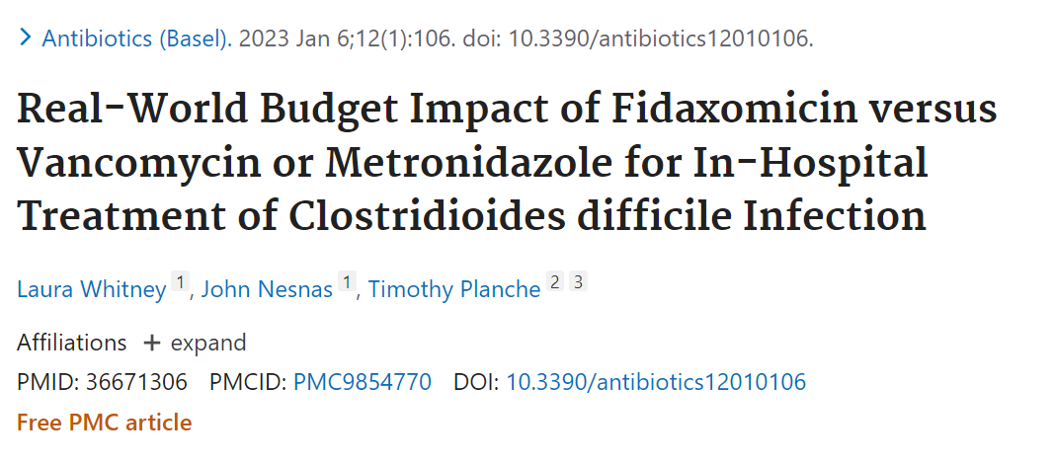
Study No. 3¹¹
Whitney L, Nesnas J, Planche T. Real-World Budget Impact of Fidaxomicin versus Vancomycin or Metronidazole for In-Hospital Treatment of Clostridioides difficile Infection. Antibiotics (Basel). 2023;12(1):106. Published Jan 6 2023. doi:10.3390/antibiotics12010106

Slide 24
Study No. 3¹¹ | Whitney L, Nesnas J, Planche T. Real-World Budget Impact of Fidaxomicin versus Vancomycin or Metronidazole for In-Hospital Treatment of Clostridioides difficile Infection. Antibiotics (Basel). 2023;12(1):106. Published 2023 Jan 6. doi:10.3390/antibiotics12010106.
Objective | Comparing the cost-effectiveness and budget of CDI treatment options in the United Kingdom: Fidaxomicin vs. vancomycin or metronidazole
Design | From April 2011 to March 2012, 86 patients with CDI were treated with vancomycin or metronidazole at a single UK hospital had their medical records retrospectively collected From August 2021 to July 2013, 62 patients with CDI treated with fidaxomicin had their medical records prospectively collected Each cohort was comparable in terms of age, concurrent antibiotic use, and gender
Results on Recurrent CDI | Fidaxomicin cohort: 6.5% of the patients had a recurrence Vancomycin/metronidazole: 19.8% of the patients had a recurrence 3/62 patients (4.8%) in the fidaxomicin cohort experience a recurrent CDI episode within 28 days of therapy completion, compared to 13/86 patients (15.1%) in the vancomycin/metronidazole cohort (P = 0.039) Fidaxomicin prevented an estimated total of 12 CDI recurrence
Results on Health Care Expenses | Compared to patients without CDI, patients with CDI had substantially greater medical expenses Group receiving fidaxomicin: additional GBP 10,748 (P-value 0.015) Vancomycin/metronidazole group: additional GBP 17,451 (P-value<0.001) Cost of CDI in patients with recurrence compared to patients who did not experience a recurrence Fidaxomicin group an average increase of GBP 8,373/patient. Vancomycin/metronidazole group an average increase of GBP 20,249/patient

Slide 25
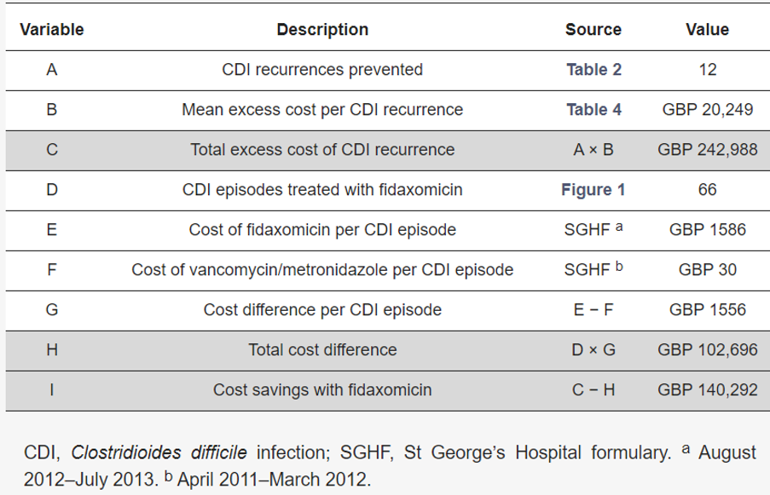
Estimated savings associated with CDI treatment (fidaxomicin vs. vancomycin or metronidazole)¹¹
Whitney L, Nesnas J, Planche T. Real-World Budget Impact of Fidaxomicin versus Vancomycin or Metronidazole for In-Hospital Treatment of Clostridioides difficile Infection. Antibiotics (Basel). 2023;12(1):106. Published Jan 6 2023. doi:10.3390/antibiotics12010106.

Slide 26
Conclusion¹¹
A limitation of this study was that it was not conducted in the United States and therefore does not use U.S. dollars. However, its findings are consistent with cost-effectiveness models conducted in various settings and countries.
Overall, the cost-savings were greater in the fidaxomicin group.

Slide 27
Recommendations
Initiate fidaxomicin in high-risk, hospitalized patients to prevent the risk of C. diff recurrence and decrease overall health care costs.
Since these studies predominantly focused on the hospital setting, vancomycin can still be administered first-line c.diff to non-severe outpatients.

Slide 28
References
Centers for Disease Control and Prevention. What is C. diff?. Available at: https://www.cdc.gov/cdiff/what-is.html. Updated September 7, 2022. Accessed June 8, 2023
Centers for Disease Control and Prevention. Your risk of C. diff. Available at: https://www.cdc.gov/cdiff/risk.html. Updated June 27, 2022. Accessed June 8, 2023.
McDonald CL, Gerding DN, Johnson S, et al. Clinical practice guidelines for clostridium difficile infection in adults and children. IDSA. Available at: https://www.idsociety.org/practice-guideline/clostridium-difficile/#RecommendationsAbbreviated. Published February 15, 2018. Accessed June 8, 2023.
Grinspan A, Surawicz CM. C. difficile infection. American College of Gastroenterology. Available at: https://gi.org/topics/c-difficile-infection/. Published December 2012. Updated April 2021. Accessed June 8, 2023.
Fidaxomicin. Lexi-Drugs. Lexi-Comp Online. Lexi-Comp, Inc. Hudson, OH. Available at:http://online.lexi.,com/crlonline. Accessed June 8, 2023.
Vancomycin. Lexi-Drugs. Lexi-Comp Online. Lexi-Comp, Inc. Hudson, OH. Available at:http://online.lexi.,com/crlonline. Accessed June 8, 2023.
Johnson S, Lavergne V, Skinner AM, et al. C. difficile 2021 focused update. IDSA. Available at: https://www.idsociety.org/practice-guideline/clostridioides-difficile-2021-focused-update/#RecommendationsAbridged. Published June 14, 2021. Accessed June 8, 2023.
Centers for Disease Control and Prevention. Prevent the Spread of C. diff. Available at: https://www.cdc.gov/cdiff/prevent.html. Updated July 20, 2021. Accessed June 8, 2023.
Mikamo H, Tateda K, Yanagihara K, et al. Efficacy and safety of fidaxomicin for the treatment of Clostridioides (Clostridium) difficile infection in a randomized, double-blind, comparative Phase III study in Japan. J Infect Chemother. 2018;24(9):744-752. doi:10.1016/j.jiac.2018.05.010.
Guery B, Menichetti F, Anttila VJ, et al. Extended-pulsed fidaxomicin versus vancomycin for Clostridium difficile infection in patients 60 years and older (EXTEND): a randomised, controlled, open-label, phase 3b/4 trial. Lancet Infect Dis. 2018;18(3):296-307. doi:10.1016/S1473-3099(17)30751-X.
Whitney L, Nesnas J, Planche T. Real-World Budget Impact of Fidaxomicin versus Vancomycin or Metronidazole for In-Hospital Treatment of Clostridioides difficile Infection. Antibiotics (Basel). 2023;12(1):106. Published 2023 Jan 6. doi:10.3390/antibiotics12010106.

