Slide 1
Ulcer Prophylaxis in Patients at Risk for GI Bleeding in the ICU
Almedina Pargan
Doctor of Pharmacy Candidate
August 25th, 2023

Slide 2
Objectives
Review FASTHUG and Stress-Related Mucosal Damage (SRMD)
Briefly compare two medication classes used for ulcer prophylaxis
Review the current clinical practice guideline for GI bleeding prophylaxis
Perform a primary literature review of two relevant studies
Determine which patient population should receive prophylaxis treatment

Slide 3
Patient Case
HPI
Polysubstance use, sepsis, and AKI secondary to rhabdomyolysis
Labs
Vitals
Upon admission
T:38.3
BP: 109/62
Oxygen Therapy: High-Flow nasal cannula
Upon admission
WBC: 17.57
RBC: 4.28
Hgb: 12.9
Cr: 6.5
CK: >22000
eGFR: 11
Urine Toxicology:
(+) Cocaine
ANO x2 (self + year)
HR: 84
Micro
8/13: 2/2 blood cx: (+) MSSA

Slide 4
FASTHUG¹
F
A
S
T
H
U
G
Feeding
Can the patient be given oral or enteral nutrition?
Hyperactive or Hypoactive delirium
addressing underlying causes and providing supportive care
Analgesia
The patient should not experience any discomfort. Appropriate pain management therapy should be administered
Ulcer Prophylaxis
Is the patient at risk for a GI bleed?
Sedation
The goal is for the patient to be calm and comfortable
Glucose Control
Maintain a target blood glucose goal of 140-180 mg/dL
Thromboembolic Prevention
Patients at high risk for VTE should receive VTE prophylaxis (UFH, LMWH, mechanical devices)

Slide 5
Stress-Related Mucosal Damage (SRMD)²
SRMD | Injuries to the upper Gl tract that can result from physiologic stress
Condition | Acute
Site of Damage | Stomach > duodenum
Symptoms | Asymptomatic
Ulcer depth | Mostly superficial
GI bleeding | Severe

Slide 6
Clinical Question
Does PUD prophylaxis decrease mortality in the ICU?

Slide 7
PPIs vs H2RAs³
PPIs
Inhibits the proton pump (H+/K+ ATPase) which prevents parietal cells from secreting gastric acid
Frequently administered once daily
Headache, GI symptoms, vitamin & mineral deficiencies, ↑ risk of infections? (C.Diff? Pneumonia?)
Inexpensive
H2RAs
Blocks histamine from binding to histamine H2 receptors, blocking the signaling cascade that increases gastric acid release
Frequently administered BID
Headache, dizziness, GI symptoms, vitamin & mineral deficiencies, skin rashes,↑ risk of infections (Pneumonia?)
Inexpensive

Slide 8
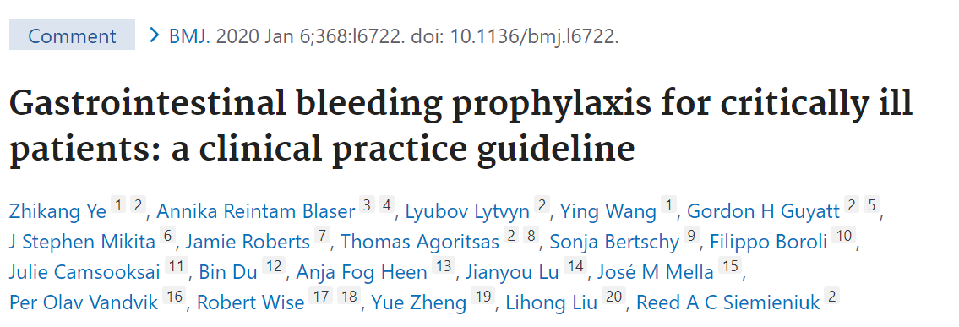
The BMJ: Prophylaxis Guideline⁴
Ye Z, Reintam Blaser A, Lytvyn L, Wang Y, Guyatt G H, Mikita J S et al. Gastrointestinal bleeding prophylaxis for critically ill patients: a clinical practice guideline BMJ 2020; 368 :l6722 doi:10.1136/bmj.l6722

Slide 9
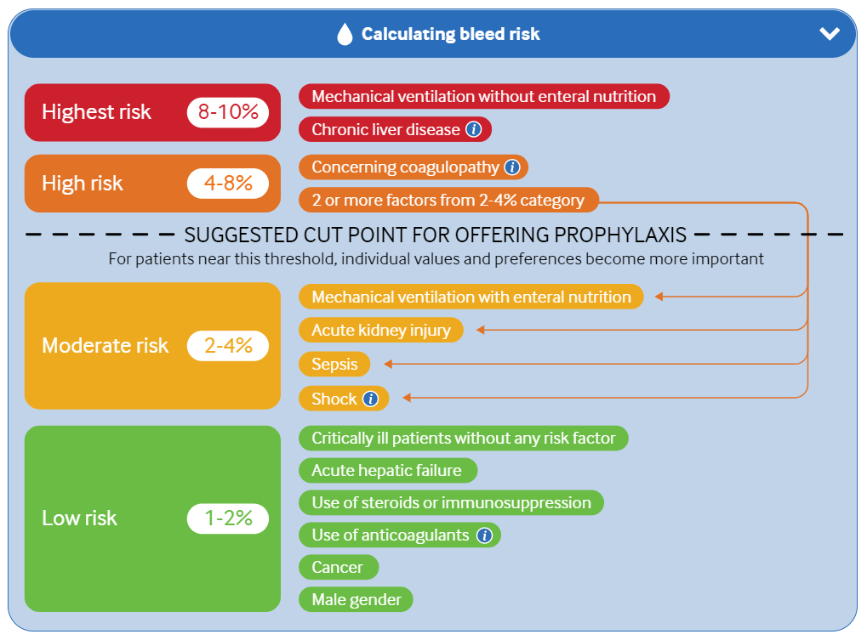
The BMJ: Prophylaxis Guideline Cont.⁴
Ye Z, Reintam Blaser A, Lytvyn L, Wang Y, Guyatt G H, Mikita J S et al. Gastrointestinal bleeding prophylaxis for critically ill patients: a clinical practice guideline BMJ 2020; 368 :l6722 doi:10.1136/bmj.l6722

Slide 10
Study No. 1: The SUP-ICU Clinical Trial⁵
Marker S, Krag M, Perner A, et al. Pantoprazole in ICU patients at risk for gastrointestinal bleeding-1-year mortality in the SUP-ICU trial. Acta Anaesthesiol Scand. 2019;63(9):1184-1190. doi:10.1111/aas.13436

Slide 11
Methods⁵
Study No. 1 | Pantoprazole in Patients at Risk for Gastrointestinal Bleeding in the ICU
Study Design | Multi-center, randomized, stratified, placebo-controlled, double-blinded, parallel clinical trial
Inclusion Criteria | > 18 years old who were admitted to the ICU and had at least one risk factor for a GI bleed
Exclusion Criteria | Ongoing daily treatment with acid suppressants Consent could not be obtained Active GI bleed Underwent organ transplant Confirmed peptic ulcer CI to pantoprazole Pregnant
Interventions | Patients were randomized 1:1 to once daily IV pantoprazole or placebo until ICU discharge or death
Primary Endpoint | Death by 90 days following randomization
Secondary Endpoints | Clinically important events in the ICU (GI bleeding, new-onset of pneumonia, C. difficile infection, acute myocardial infection) Clinically important GI bleeding in the ICU Infectious adverse events in the ICU (pneumonia or C. difficile) Serious adverse reaction

Slide 12
Methods⁵
10,000 patients were accessed for eligibility
3,298 patients were enrolled in the trial
1,645 patients were assigned to pantoprazole
1,653 patients were assigned to placebo
1,642 patients were included in the primary outcome analysis
1,644 patients were included in the secondary outcome analysis
1,640 patients were included in the primary outcome analysis
1,647 patients were included in the secondary outcome analysis

Slide 13
Results⁵
Primary Outcome | Pantoprazole | Placebo | Relative Risk (95% CI) | P Value
Death by 90 days following randomization | 510/1642 (31.1) | 499/1640 (30.4) | 1.02 (0.91-1.13) | 0.76
Secondary Outcome | Pantoprazole | Placebo | Relative Risk (95% CI) | P Value
Clinically important events in the ICU (GI bleeding, new-onset of pneumonia, C. difficile infection, acute myocardial infection) | 360/1644 (21.9) | 372/1647 (22.6) | 0.96 (0.83-1.11) | N/A
Clinically important GI bleeding in the ICU | 41/1644 (2.5) | 69/1647 (4.2) | 0.58 (0.84-0.86) | N/A
Infectious adverse events in the ICU (pneumonia or C. difficile) | 276/1644 (16.8) | 279/1647 (16.9) | 0.99 (0.84-1.16) | N/A
Serious adverse reaction | 0/1644 (0) | 0/1644 (0) | N/A | N/A
Notes:
nnt

Slide 14
Results⁵
Subgroup: Primary Output | Pantoprazole | Placebo | RR (95% CI) | P value
Shock at randomization |  |  |  | 0.92
Yes No | 413/1251 97/391 | 395/1210 104/430 | 1.01 (0.90-1.13) 1.02 (0.80-1.31)
Mechanical ventilation at randomization |  |  |  | 0.74
Yes No | 399/1272 111/370 | 400/1310 99/330 | 1.03 (0.91-1.16) 0.98 (0.77-1.25)
Coagulopathy at randomization |  |  |  | 0.54
Yes No | 361/1045 149/597 | 118/299 381/1341 | 0.95 (0.77-1.17) 1.03 (0.91-1.16)
History of liver disease |  |  |  | 0.69
Yes No | 20/44 149/597 | 25/48 474/1592 | 0.93 (0.60-1.44) 1.02 (0.92-1.14)

Slide 15
Study Conclusion⁵
In terms of clinically significant GI bleeding in the ICU, there was a statistical difference between the two groups
There was no statistical difference in the incidence of death, infectious adverse events, and serious ADE between the two groups

Slide 16
Strengths and Limitations
Strengths
Increased External Validity
Multi-Center: 33 health facilities
Large sample size
Performed a subgroup analyses
To determine if pantoprazole's effects are dependent on patient factors (liver disease, coagulopathy, hypotension, mechanical ventilation, or type of ICU admission)
Limitation
Type 1 error (false-positive)
Researchers did not apply correction for multiple comparisons for secondary outcome

Slide 17
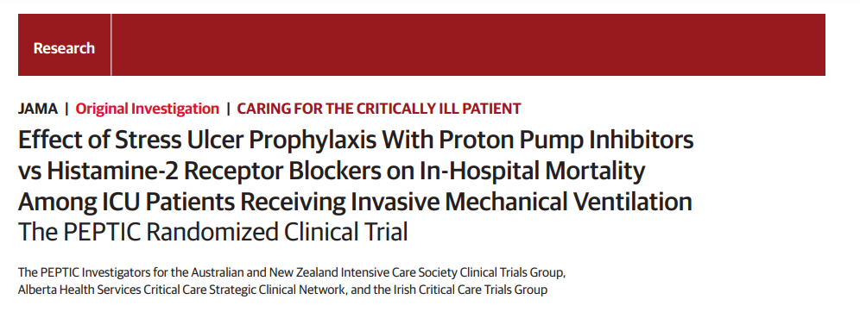
Study No. 2: The PEPTIC Clinical Trial⁶
PEPTIC Investigators for the Australian and New Zealand Intensive Care Society Clinical Trials Group, Alberta Health Services Critical Care Strategic Clinical Network, and the Irish Critical Care Trials Group, Young PJ, Bagshaw SM, et al. Effect of Stress Ulcer Prophylaxis With Proton Pump Inhibitors vs Histamine-2 Receptor Blockers on In-Hospital Mortality Among ICU Patients Receiving Invasive Mechanical Ventilation: The PEPTIC Randomized Clinical Trial. JAMA. 2020;323(7):616-626. doi:10.1001/jama.2019.22190

Slide 18
Methods⁶
Study No. 2 | The PEPTIC Randomized Clinical Trial
Objective | To compare the mortality rates of hospitals using PPIs versus H2RAs for stress ulcer prophylaxis
Study Design | Cluster crossover randomized open-label clinical trial
Inclusion Criteria | > 18 years old Required invasive mechanical ventilation within 24 hours of ICU admission
Exclusion Criteria | Diagnosed with an upper GI bleed
Interventions | 25 hospitals: PPIs x 6 months, then H2RAs x 6 months 25 hospitals: H2RAs x 6 months, then PPIs x 6 months
Primary Endpoint | All – cause mortality within 90 days during hospitalization
Secondary Endpoints | Clinically important upper GI bleed C. difficile infection

Slide 19
Methods⁶
50 ICUs randomized
25 ICUs randomized to use of PPIs → H2RA
5,670 patients randomized to PPI group
5,600 patients randomized to H2RA group
25 ICUs randomized to use of H2RA → PPIs
7,871 patients randomized to H2RA group
5,659 patients included in the primary outcome analysis
5,574 patients were included in the primary outcome analysis
7,841 patients randomized to PPI group
7,782 patients were included in the primary outcome analysis
7,756 patients were included in the primary outcome analysis
13,415 patients were included in the primary outcome analysis for the PPI group
13,356 patients were included in the primary outcome analysis for the H2RA group

Slide 20
Results⁶
Primary Outcome | PPIs | H2RAs | RR (95% CI) | ARR (95% CI) | P Value
All – cause mortality within 90 days during hospitalization | 2459/13415 (18.3) | 2333/13356 (17.5) | 1.05 (1.00-1.10) | 0.93 (-0.01-1.88) | 0.054
Secondary Outcomes | PPIs | H2RAs | RR (95% CI) | ARR (95% CI) | P Value
Clinically important upper GI bleed | 172/13436 (1.3) | 239/13392 (1.8) | 0.73 (0.57-0.92) | -0.52 (-0.90- -0.12) | 0.009
C. difficile infection | 40/13436 (0.30) | 57/13392 (0.43) | 0.74 (0.51-1.09) | -0.11 (-0.25-0.03) | .13

Slide 21
Study Conclusion⁶
Fewer patients who received proton pump inhibitors experienced clinically significant bleeding. These findings indicate a statistical and clinical difference between the two treatment groups
However, the difference between the two treatment groups’ mortality rates and C. diff infection was not statistically significant

Slide 22
Strengths and Limitations
Strengths
Increase in external validity
Multi-center: 50 ICUs
Large sample size
Decreases the risk of selection bias
Crossover study
Limitation
Risk for performance bias
Open-labeled: clinician and patient
The clinician determined which patient would receive ulcer prophylaxis

Slide 23
Recommendation
The estimated mortality rate due to an upper gastrointestinal bleed is between 2-15%⁷
There is no direct reduction in mortality with ulcer prophylaxis in the ICU according to the two studies, however, there is a clinically significant reduction in upper GI bleed, and by preventing a GI bleed, mortality can be prevented
Patient Case: Initiate Pantoprazole (Protonix®) 40 mg IV daily
Monitor: RBC, Hgb and Hct

Slide 24
Patient Case
HPI
Polysubstance use, sepsis, and AKI secondary to rhabdomyolysis
Labs
Vitals
Upon admission
T:38.3
BP: 109/62
Oxygen Therapy: High-Flow nasal cannula
Upon admission
WBC: 17.57
RBC: 4.28
Hgb: 12.9
Cr: 6.5
CK: >22000
eGFR: 11
Urine Toxicology:
(+) Cocaine
ANO x2 (self + year)
HR: 84
Micro
8/13: 2/2 blood cx: (+) MSSA

Slide 25
References
Mabasa VH, Malyuk DL, Weatherby EM, Chan A. A Standardized, Structured Approach to Identifying Drug-Related Problems in the Intensive Care Unit: FASTHUG-MAIDENS. Can J Hosp Pharm. 2011;64(5):366-369. doi:10.4212/cjhp.v64i5.1073
Love BL. Peptic Ulcer Disease and Related Disorders. In: DiPiro JT, Yee GC, Haines ST, Nolin TD, Ellingrod VL, Posey L. eds. DiPiro’s Pharmacotherapy: A Pathophysiologic Approach, 12th Edition. McGraw Hill; 2023. Accessed August 24, 2023. https://accesspharmacy-mhmedical-com.maproxy.palni.edu/content.aspx?bookid=3097&sectionid=267240133
Multi-entries. Lexi-Drugs. Lexi-Comp Online. Lexi-Comp, Inc. Hudson, OH. Available at: http://online.lexi.com/crlonline. Accessed August 18, 2023
Ye Z, Reintam Blaser A, Lytvyn L, Wang Y, Guyatt G H, Mikita J S et al. Gastrointestinal bleeding prophylaxis for critically ill patients: a clinical practice guideline BMJ 2020; 368 :l6722 doi:10.1136/bmj.l6722
Marker S, Krag M, Perner A, et al. Pantoprazole in ICU patients at risk for gastrointestinal bleeding-1-year mortality in the SUP-ICU trial. Acta Anaesthesiol Scand. 2019;63(9):1184-1190. doi:10.1111/aas.13436
PEPTIC Investigators for the Australian and New Zealand Intensive Care Society Clinical Trials Group, Alberta Health Services Critical Care Strategic Clinical Network, and the Irish Critical Care Trials Group, Young PJ, Bagshaw SM, et al. Effect of Stress Ulcer Prophylaxis With Proton Pump Inhibitors vs Histamine-2 Receptor Blockers on In-Hospital Mortality Among ICU Patients Receiving Invasive Mechanical Ventilation: The PEPTIC Randomized Clinical Trial. JAMA. 2020;323(7):616-626. doi:10.1001/jama.2019.22190
Antunes C, Copelin II EL. Upper Gastrointestinal Bleeding. [Updated 2023 Apr 7]. In: StatPearls [Internet]. Treasure Island (FL): StatPearls Publishing; 2023 Jan-. Available from: https://www.ncbi.nlm.nih.gov/books/NBK470300/

